Slide 1
Module 12:HIV and AIDS
CODE:HVA 1103
HOURS:30
CREDITS:3
Lecturer :Lydiah Cheyech

Slide 2
Behavior Change Communication(BCC) and Attitude Training
OBJECTIVES:
By the end of the lesson, the learner should be able to:
Define Behavior change communication
Describe the theories of BCC
State goals of BCC
Explain the guiding principles of BCC
understand how BCC programs impact on positive health outcomes
develop environments that enable the maintenance of positive health behaviors

Slide 3
Introduction
Anyone who has ever made and broken a New Year’s resolution can appreciate the difficulty of behavior change.
Making a lasting change in behavior is rarely a simple process and usually involves a substantial commitment of time, effort, and emotion.

Slide 4
Intro…
To succeed, one need to understand the three most important elements in changing a behavior:
Readiness to change: having the resources and knowledge to make a lasting change successfully
Barriers to change: Anything preventing one from changing.
Expect relapse: What might trigger a return to a former behavior.

Slide 5
Intro..
Whether you want to lose weight, stop smoking, or accomplish another goal, there is no single solution that works for everyone. You may have to try several different techniques, often through a process of trial-and-error, to achieve your goal.
It's during this period that many people become discouraged and give up on their behavior change goals. The key to maintaining your goals is to try new techniques and find ways to stay motivated.

Slide 6
Behavior change
Changing behavior is a very important part of Behavior Change Communication and it is important that people working in this area have an understanding of the behavior change process.
Human behavior, particularly when related to health is a complicated area to understand and over the years
there have been many theories devised in an attempt to explain why certain behaviors occur.
Health behaviors are behaviors that a person engages in to prevent a disease or health problem occurring or to prevent an existing disease or health problem from getting worse.
Like other behaviors, a health behavior is motivated by stimuli in an individual’s environment.For example, an

Slide 7
Behavior change…
individual who smokes may be finding that they are getting increasingly puffed when they walk up stairs and this may be the stimuli that motivate them to quit smoking.
The motivation to change a behavior isn’t always related to a health reason but may indirectly affect the person’s health.
For example a young woman may start an exercise program to look good rather than for the health benefits that will be gained from exercising.

Slide 8
Cont
By understanding some of the factors that motivate behavior the health promotion practitioner can address the challenge of selecting strategies and methods to change behavior in order to improve overall health.

Slide 9
Levels of Influence in Behavior Change
Behavior may be influenced by:
Rational Elements e.g. A woman may not attend the Ante Natal Clinic because she does not understand why an Ante Natal Check is important to the health of her baby.
Interpersonal Elements e.g. A woman may not attend the Ante Natal Clinic because she knows her doctor as a friend and is too embarrassed or she does not want to go to a male doctor.
Practical Elements e.g. A woman does not attend the Ante Natal Clinic because she is unable to visit the clinic during clinic hours due to her work and family commitments.
Structural Elements factors, e.g. A woman does not attend Ante Natal Clinic because she lives a long way away from the clinic and there is no transport to allow her to get to the clinic.

Slide 10
Cont..
Emotional Elements e.g. A woman does not perceive that there is any health risks associated with being pregnant and that she is in no way vulnerable.
Antecedents to Behavior Change describes antecedent determinants of behavior as something that occurs before a behavior.

Slide 11
consequences of a Behavior
What happens, as a result of a behavior will also influence whether the behavior continues or stops.
A consequence can provide negative or positive reinforcement.
May strengthen, weaken or stop a behavior.
A consequence that occurs immediately after a behavior is the most powerful in influencing that behavior.
How important or relevant the consequence is to the individual will affect the behavior.
Concrete consequences are more likely to cause change than abstract ones.

Slide 12
Cont
For example, if someone is stressed and feels calmer after having a cigarette, then they will probably continue to smoke whenever they get stressed.
Alternatively, if someone coughs a lot after having a cigarette and feels short of breath, then this might be a consequence that deters them from smoking.
When working with an individual who might want to change a particular behavior, it is important to explore the antecedents and consequences of that behavior so that appropriate strategies can be devised to address them

Slide 13
BCC Definition
is a process of working with individuals, families and communities through different communication channels to promote positive health behaviors and support an environment that enables the community to maintain positive health behaviors taken on.
BCC is an interactive process for developing messages and approaches using a mix of communication channels in order to encourage and sustain positive and appropriate behavior.

Slide 14
BCC cont..
BCC is the strategic use of communication to promote positive health outcomes, based on proven theories and models of behavior change. BCC employs a systematic process beginning with formative research and behavior analysis, followed by communication planning, implementation, and monitoring and evaluation.
Audiences are carefully segmented, messages and materials are pre-tested, and both mass media and interpersonal channels are used to achieve defined behavioral objectives.

Slide 15
Cont.….
BCC must be research based client centered benefit oriented service linked professionally developed and linked to behavior change.

Slide 16
BCC cont..
BCC Moves People From Awareness to Action!
For some time it has become clear that while Information Education and Counselling(IEC) programs have resulted in improved health knowledge they have often failed to produce behavior change.
IEC campaigns are often better at imparting knowledge and information than they are at moving people from awareness to action. Behavior change is a complex process motivated by many factors including:
A persons awareness of the need to change,
A persons understanding of the benefits of such a change, A persons belief in their ability to change
A person having the confidence in their ability to maintain a behavior change.

Slide 17
BCC…
To be successful, BCC must move people from awareness to action by motivating people to believe that health benefits will be obtained by changing behavior and by increasing individuals’ sense of control over their own health behavior choices.
BCC must go beyond just providing information to an approach that provides both information and appeals to individuals emotions.

Slide 18
The BCC theories
BCC programs can be used to improve health, reduce disease risks, manage chronic illness and improve the overall well-being of individuals, families and communities.
There are many theories of health behavior and these theories have been helpful when planning, implementing and evaluating Behavior Change Communication interventions.
Behavior change theories provide the building blocks for understanding health behavior and how it can be influenced.”

Slide 19
The BCC THEORIES
BCC has several levels at which it can be implemented. Each level includes several theories. Each level (and each theory) employs specific communication channels.
Individual level
Health belief theory
Theory of reasoned action and planned behavior
Stages of change
Social learning
Community level
Diffusion of innovations theory
Community mobilization

Slide 20
Health Belief Theory
The Health Belief Model highlights how programs need to consider individual beliefs about the problem being addressed and the costs and barriers associated with changing a behavior.
The Health Belief Model is based on the understanding that a person is likely to change behavior if he/ she experiences:
Perceived susceptibility/seriousness: One believes he/she is at risk. (For example, Jane believes she is at risk of becoming pregnant.)

Slide 21
Health belief model cont..
Perceived benefits: One believes that the behavior change will reduce risk. (For example, Jane believes that using contraception will reduce her risk of unintended pregnancy.)
Perceived barriers: How one interprets the cost/barriers of the desired behavior. (For example, Jane believes that her partner would not want her to use contraception, but, for her, the benefits of using contraception outweigh his reaction.)

Slide 22
Health belief model cont..
Cues to action: Strategies to activate “readiness." (For example, Jane receives education about contraception and the different options available to her.)
Self-efficacy: Confidence in one’s ability to take action. (For example, Jane feels confident that she can access contraception and that she can use it correctly to avoid unintended pregnancy.)

Slide 23
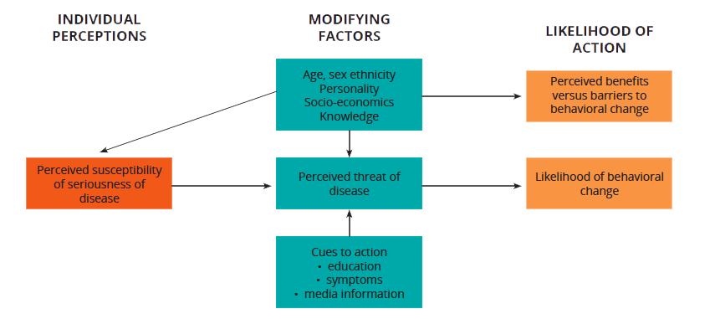
Health belief model cont..

Slide 24
Applying Health Belief Model
This Model is best used when promoting individual preventive behaviors, such as condom use or getting vaccinations.
It focuses on the beliefs and perceptions of the individual, so it is appropriate to change behaviors that are not heavily influenced by society and social norms.
It tells us the importance of highlighting both the negative consequences of the current behavior and the positive consequences of alternative, suggested behavior.

Slide 25
Theory of Planned behavior
According to the Theory of Planned Behavior (the original insight of Theory of Reasoned Action), behavior is influenced by three elements:
Attitude: That the behavior will be beneficial to the individual. (For example, Jane feels that using contraception is a good way for her to prevent pregnancy.)
Subjective norms: The belief that other people think that the behavior is acceptable. (For example, Jane believes her partner, friends and family would support her using contraception.)
Perceived ability: The belief that one has the skills and capability to change behavior. (For example, Jane believes she is able to access and use contraception successfully to prevent unintended pregnancy.)

Slide 26
Applying theory of planned behavior
The Theory of Planned Behavior can be used to change behaviors that are heavily influenced by peers and the close social network.
This theory tells us that the close social network needs to be targeted to support the desired behavior change in the individual, as well as that it is important to highlight the short-term benefits of the behavior change to promote action.

Slide 27
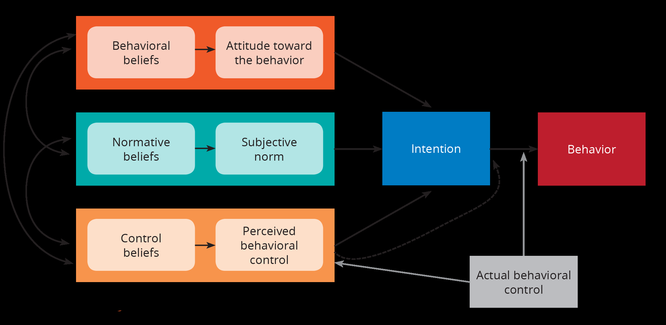
Cont.…

Slide 28
Stages of change theory
The Stages of Change Model has a significant influence on BCC. The model was developed by Prochaska and Di Clemente in 1982 and focuses on an individual’s readiness to change or attempt to change a behavior.
It evolved from work done with smoking cessation and the treatment of drug and alcohol addiction and works on the idea that behavior change is a process and that it is important to identify at what level of readiness an individual is at, if they are to make a change in their behavior.
Because individuals are at different stages of readiness to change, they can benefit from a range of interventions that are appropriate to the stage they are at.

Slide 29
Stages of change…
The Stages of Change (sometimes called the Trans theoretical Model) tells us that individuals go through different stages when changing a behavior. This theory assumes that individuals have different degrees of motivation and readiness to change, which determine their current stage of change.
According to this theory, different stages of change require different information needs and approaches to try and move the audience to the following stage. Although people may move through these stages in a predictable way, an individual can drop back or jump over stages. The stages are:

Slide 30
Stages of change…
Precontemplation: There is no intention to change behavior in the future. (For example, Jane is not thinking about using contraception to avoid unintended pregnancy.)
Contemplation: An individual is aware that the problem exists and is seriously thinking about overcoming it, but has not yet made a commitment to take action. (For example, Jane has learned about contraception and is thinking about starting to use it.)

Slide 31
Stages of change…
Preparation: An individual intends to take action immediately. (For example, Jane is planning to go to the health facility this month to start using contraception.)
Action: An individual begins performing the behavior. (For example, Jane starts using contraception to avoid unintended pregnancy.)

Slide 32
Stages of change….
Maintenance: An individual continues the behavior and works to maintain it. (For example, Jane continues using the contraception of her choice consistently and correctly.)
Some SBCC professionals have added a sixth stage to this model – Advocacy.
Advocacy is the stage in which Jane is maintaining her use of contraception, as well as promoting the benefits of contraception to her friends and encouraging them to try it, too.

Slide 33
CONCEPT | DEFINATION | APPLICATION
Pre-contemplation | Unaware of their problem. Hasn’t thought about change. Not consciously intending to change | Increase awareness of need for change, personalize information on risks and benefits of changing.
Contemplation | Thinking about change in the near future. | Motivate and encourage to make specific plans.
Decision/determination Preparation | Making a serious commitment and a plan to change. | Assist in developing concrete action plans and setting gradual goals.
Action | The stage at which behavior change is initiated. | Assist with feedback, problem solving and social support and provide reinforcement.
Maintenance | Sustaining the change and achievement of predictable health gains. Relapse can occur. | Assist in coping, reminders, finding alternatives, avoiding slips/relapses

Slide 34
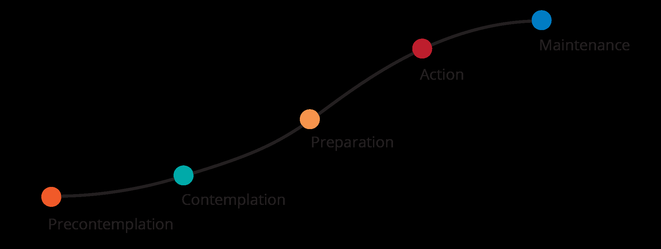
Cont..

Slide 35
Applying stages of change theory
Stages of Change can be used in one-to-one situations, for example, between a client and a counselor.
Knowing the stage of change of the client can help the counselor select what information to share.
Information at the precontemplation and contemplation stages would focus on facts, the risks of the current behavior and the benefits of changing behavior.
At the preparation and action phases, it would focus more on opportunities for changing behavior and how to access them.

Slide 36
Social learning theory
Theory acknowledges the interaction that occurs between an individual and his/her environment.
The outside environment is where a person can observe an action, understand its consequences, and become motivated to repeat it and adopt it.
Behavior is affected by structural factors, such as service availability and policies, as well as by social factors, such as social norms and peer influence.

Slide 37
Cont..
In the application of the Social Learning Theory, the learner (audience) is encouraged to:
Observe and imitate the behavior of others. (For example, Jane may observe her friend Rose using contraception and therefore decide that she wants to use contraception, too.)
See positive behaviors modeled and practiced. (For example, Jane sees that her friend Rose is happy with the contraception method she has chosen. This makes her want to copy and model the same behavior.)

Slide 38
Social learning theory…
Increase his/her own capability and confidence to implement new skills. (For example, when Jane’s community becomes more supportive of and vocal about access to contraception for adolescent girls her age, she gains the confidence to talk to her mother about getting contraception.)
Gain positive attitudes about implementing those skills. (For example, after learning about how to use her contraceptive method, Jane feels confident that she can maintain use and keep on track to achieving her dreams.)
Experience support from his/her environment to use those skills. (For example, Jane learns that her health clinic stays open late and on weekends to support youth like her that work or go to school during the day, meaning she has better access to her counselor and to SRH services.)

Slide 39
Applying social learning theory
The Social Learning Theory can be used for behaviors that are heavily influenced by both the physical and social environment in which the individual lives.
The theory tells us the importance of creating an enabling environment, in which the desired behavior change is made easier.
It also tells us that seeing the behavior in practice can help others adopt it.
This can be done through modeling, where the desired behavior, as well as the resulting benefits, can be demonstrated and popularized by role models.
Modeling can come from real or fictional characters depicted through different media channels.

Slide 40
Diffusion of innovations theory
Diffusion of Innovation refers to the spread of new ideas and behaviors within a community or from one community to another.
Some individuals and groups in society are quicker to pick up new ideas, or “innovations,” than others. Young people are typically associated with adopting new trends, such as fashion or technology, more quickly than adults.
This theory identifies five categories that define a person’s propensity to accept or adopt the innovation:
Innovators: the quickest to adopt an innovation. However, they may be seen as fickle by other community members and are less likely to be trusted and copied.

Slide 41
Cont..
Early adopters: more mainstream within the community and are characterized by acceptance of innovation and some personal/financial resources to be able to adopt the innovation.
Early majority: amenable to change and persuaded of the benefits of the innovation by observing.
Late majority: skeptical and reluctant to adopt new ideas until the benefits are clearly established.
Laggards: these are most conservative and resistant to change; sometimes, they may never change.
The likelihood of adopting an innovation/behavior depends on the audience, environmental barriers and facilitators, the communication system and the innovation’s attributes, such as:

Slide 42
Cont..
Relative advantage: does the behavior offer an advantage over the current behavior? (For example, does using contraception offer Jane a benefit (e.g., peace of mind) she currently doesn’t have?)
Compatibility: is the behavior compatible with prevailing social and cultural values? (For example, is it culturally acceptable for a girl like Jane to use contraception?)
Complexity: how difficult is the new behavior to perform? (For example, would Jane be able to manage maintaining her contraceptive method?)

Slide 43
Cont..
Triability: can the behavior be tried out without too much risk? (For example, is it possible for Jane to try out a contraceptive method and see what it’s like?)
Observability: are there opportunities to see what happens to others who adopt the behavior? (For example, does Jane have access to friends who are using contraception that can talk to her about it?)

Slide 44
Applying diffusion of innovation theory
Diffusion of Innovation can be used to change behaviors that are influenced by social norms and social trends.
The theory tells us how to promote the desired behavior by focusing on attributes. This can be done through agents of change, that is, the early adopters of a new behavior who promote it and encourage others to adopt it.

Slide 45
Cont..
Agents of change can be people working in the community or community members who have adopted the new behavior and can act as role models.
Targeting effective agents of change, such as local leaders, influential individuals, peers and celebrities, can accelerate the adoption of a new behavior.

Slide 46
Community mobilization model
The Community Mobilization Framework is one way to systematically conceptualize the organization of the community for the purpose of mobilizing the maximum number of community members around a common health initiative. A community becomes mobilized around an issue by endorsing health-enhancing attitudes, behaviors, and projects supporting positive health outcomes.

Slide 47
Community motivation…
This mobilization is expressed through the promotion, support, and delivery of motivational and informational health messages which convey consistent ideas, themes, and images.
There are two fundamental bases of the Community Mobilization Framework:
is its characterization of the variety of individual, social, and organizational roles and relationships in the community.
the description of the nature and extent of the involvement, which includes a continuum of involvement, ranging from simple endorsement to building active coalitions around a health initiative.

Slide 48
Framework for BCC design
BCC is the comprehensive process in which one passes through the stages:
Unaware
Aware
Concerned
Knowledgeable
Motivated to change
Practicing trial behavior change
Sustained behavior change

Slide 49
Developing effective BCC strategy
Consists of the following steps:
State program goals
Involve stakeholders and other key people
Identify target populations/audience
Conduct formative BCC assessments
Segment target populations
Define behavior change objectives
Define BCC strategy & monitoring and evaluation plan
Develop communication products
Pretest
Implement and monitor
Evaluate
Analyze feedback and revise

Slide 50
strategy development and planning
BCC is different from the ordinary instructional method of communication and is target specific.
A society consists of many sub-groups. The strategy for BCC will vary from group to group.
The following points are important while considering the BCC strategy.
Vulnerability/risk factor of the target group
The vulnerability/risk factor of the group which is to be addressed
The conflict and obstacles in the way to desired change in behavior
Type of message and communication media which can best be used to reach the target group
Type of resources available and assessment of existing knowledge of the target group about the issue which is going to be dealt with

Slide 51
Cont ..
Individual Approaches
BCC on a one-to-one basis is an important part of many health service providers’ work.
This one-to-one BCC focus continues to play an important role particularly in the area of secondary prevention (ie. when you want to reverse the early symptoms of disease) and tertiary prevention (ie. when you want to slow the progress of a disease which already exists).
Individual methods in primary prevention are not as cost effective if you are targeting large target audiences although it can be useful in reducing risk factors for certain diseases.

Slide 52
Individual Approach cont…
The main methods of individually focused BCC are patient education and information, counseling and risk assessment/screening.
These methods can occur in hospitals and other health care settings such as general practice surgeries and community health centers, as well as in the community.
The advantages of an individually focused activity is that they can be personalized and the health service provider is often seen as a credible source of information.
limitations. Individual approaches are time consuming, not cost effective and very labor intensive. However when applied at the right moment in the right way, individual methods can be highly effective.

Slide 53
Group Approach
Group methods of Behavior Change Communication have been used widely and offer an intermediary approach between one-to-one approaches and wider community approaches.
Groups can vary in size and methods used for groups can be classified as being didactic or experiential. Didactic methods include lectures, seminars, workshops and conferences, although active participation is often also a part of these methods. Experiential methods include skills training, behavior modification, inquiry learning/problem solving, simulation, role play and self-help groups.

Slide 54
Cont…
Group methods have been shown to have a role in assisting individuals to gain knowledge and change attitudes and behavior, as well as providing a supportive setting for people who may share a common goal (such as a group of antenatal mothers living wit HIV).
They can also play a role in assisting members of a community or organization to improve their ability in approaching their own health problems or getting them empowered to facilitate change within their community or organization.
For group approaches to BCC to be effective, an experienced facilitator or group leader is very important.

Slide 55
Community Approach
Community based approaches to BCC can potentially have a greater impact on a larger amount of people. One of the principles of BCC is work with individuals, families and communities to support an environment that enables the community to maintain positive health behaviors take on.
BCC works through concrete and effective community action in setting priorities, making decisions, planning strategies and implementing them to achieve better health.

Slide 56
CONT..
By developing this principle some major changes can potentially be made at a community level as a result of community based BCC programs.

Slide 57
The BCC goals
Major goals for health are to enable people: - To define their own problems and needs - To understand what they can do about these problems with their own resources combined with outside support - To decide on most appropriate action to promote healthy living and community well being

Slide 58
BCC goals: objectives
Increase perception of risk or change attitudes toward use of condoms
Increase demand for services
Create demand for information on HIV and AIDS
Create demand for appropriate STI services
Interest policymakers in investing in youth friendly VCT services (services must be in place)
Promote acceptance among communities of youth sexuality and the value of reproductive health services for youth (services must be in place)

Slide 59
BCC GOALS FOR HIV/AIDS
Program goal: Reduce HIV prevalence among young people in urban settings in country
Behavior change goals: • Increase condom use • Increase appropriate STI care-seeking behavior • Delay sexual introduction • Reduce number of partners

Slide 60
Principles of BCC
Assignments

Slide 61
ROLE OF BCC IN HIV & AIDS
Increase knowledge : BCC can ensure that people are given the basic facts about HIV and AIDS in a language or medium that they can understand and relate .
Stimulate community dialogue : BCC can encourage community and national discussions on the basic facts of HIV/AIDS & the underlying factors that contribute to the epidemic, such as risk behaviors and risk settings, environments and cultural practices related to sex and sexuality .

Slide 62
ROLE OF BCC IN HIV & AIDS
Promote essential attitude change : BCC can lead to appropriate attitudinal changes about, for eg,perceived personal risk of HIV infection, belief in the right to and responsibility for safe practices and health supporting services etc .
Advocate for policy changes : BCC can lead policymakers and opinion leaders toward effective approaches to the epidemic.
Improve skills and sense of self-efficacy: It can focus on teaching or reinforcing new skills and behaviors, such as condom use, negotiating safer sex and safe injecting practices .

Slide 63
ROLE OF BCC IN HIV & AIDS
Create a demand for information and services: BCC can spur individuals and communities to demand information on HIV/AIDS and appropriate services.
Reduce stigma and discrimination: Communication about HIV prevention and AIDS mitigation should address stigma and discrimination and attempt to influence social responses to them .

Slide 64
ROLE OF BCC IN HIV & AIDS
Promote services for prevention and care : BCC can promote services for STIs, intravenous drug users (IDUs), orphans and vulnerable children (OVCs); voluntary counseling and testing (VCT) for mother-to-child transmission (MTCT); support groups for PLHA; clinical care for opportunistic infections; and social and economic support.

Slide 65
ATTITUDE TRAINING
Risks exploration
Previous and current risks
Predisposing factors
Vulnerability and prevention
Networking
Fluid exchange attitude and cultural practices
Attitudes and beliefs towards HIV& AIDS
Cultural practices

Slide 66
Ethical issues related to disclosure

